Slide 1
Multiple Linear Regression Using Python Problem of Multicollinearity Normality of Errors

Slide 2
Problem of Multicollinearity
Multicollinearity exists if there is strong linear relationship among the independent variables
Multicollinearity has two serious consequences:
Therefore, it is important to check for Multicollinearity in regression analysis
1. Highly Unstable Model Parameters As standard errors of their estimates are inflated
2. Model Fails to Accurately Predict for Out of Sample Data

Slide 3
Detecting Multicollinearity Through VIF
VIF (Variance Inflation Factor) Method:
Dependent Variable : Y
Independent variables : X1, X2, X3, X4
Dependent Variable | Independent Variables | R² | 1 – R² = Tolerance | VIF = 1/(Tolerance)
X1 | X2, X3, X4
X2 | X1, X3, X4
X3 | X1, X2, X4
X4 | X1, X2, X3
Any VIF > 5, indicates presence of Multicollinearity

Slide 4
Detecting Multicollinearity in Python
#Importing the Data, Fitting Linear Model
import pandas as pd perindex=pd.read_csv("Performance Index.csv") import statsmodels.formula.api as smf jpimodel=smf.ols('jpi~aptitude+tol+technical+general',data=perindex).fit()
#Variance Inflation Factor
from patsy import dmatrices from statsmodels.stats.outliers_influence import variance_inflation_factor # Break data into left and right hand side; y and X y, X = dmatrices('jpi ~ aptitude + tol + technical +general', data=perindex, return_type="dataframe")
patsy is a library that helps in converting data frames into design matrices.
dmatrices Construct two design matrices using specified formula.By convention, the first matrix is the "y" data, and the second is the "x" data.
variance_inflation_factor() requires a design matrix as input to calculate vif.
*
We use the same dataset “Performance Index” which was used in previous ppt

Slide 5
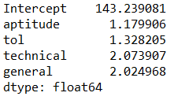
Detecting Multicollinearity in Python
# Calculating VIF & getting vif with their corresponding variable # name
vif = pd.Series([variance_inflation_factor(X.values, i)for i in range(X.shape[1])],index=X.columns) vif
variance_inflation_factor() calculates VIFs.
# Output
Interpretation :
All VIFs are less than 5, Multicollinearity is not present.

Slide 6
Multicollinearity – Remedial Measures
The problem of Multicollinearity can be solved by different approaches:
Drop one of the independent variables, which is explained by others
Use Principal Component Regression in case of severe Multicollinearity
Use Ridge Regression
*
Dropping a variable may not be a good idea if many VIFs are large.
Principal Component Method will be discussed in detail under Data Reduction and Segmentation

Slide 7
Normality of Errors
The errors in Multiple Linear Regression are assumed to follow Normal Distribution.
If Normality of Errors is not true then statistical tests and associated P values based on F and t distribution are not reliable.

Slide 8
Residual Analysis
Observed Value – Predicted value = Residual
Residuals v/s Predicted Plot
Checks randomness of errors
Quantile-Quantile Plot
Residual Analysis
Shapiro Wilk Test
Checks distribution of errors
Kolmogorov-Smirnov (KS) Test

Slide 9
Residual Analysis for Performance Index Data
Continuing with the “Performance Index “ data,
Model job performance index ( jpi ) based on aptitude score ( aptitude ), test
of language ( tol ), technical knowledge ( technical ) and general information
( general )
Get fitted values and residuals.
Analyse the distribution of residuals

Slide 10
Residual v/s Predicted Plot in Python
#Importing the Data, Fitting Linear Model and Calculating Fitted Values and Residuals
import pandas as pd perindex= pd.read_csv("Performance Index.csv") import statsmodels.formula.api as smf jpimodel = smf.ols('jpi ~ tol + aptitude + technical +general', data=perindex).fit() perindex = perindex.assign(pred=pd.Series(jpimodel.fittedvalues)) perindex = perindex.assign(res=pd.Series(jpimodel.resid))
ols() fits a linear regression.
fittedvalues() and resid() fetch fitted values and residuals
#Residuals v/s Predicted Plot
perindex.plot.scatter(x='pred', y='res')
.plot.scatter() is used to obtain scatter plot of predicted values against residuals.

Slide 11
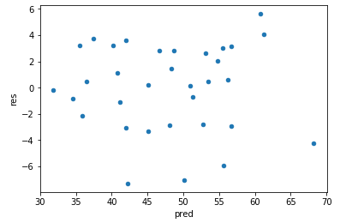
Residual v/s Predicted Plot in Python
# Output
Interpretation:
Residuals in our model are randomly distributed which indicates presence of Homoscedasticity

Slide 12
QQ Plot
The Quantile-Quantile (QQ) Plot is a powerful graphical tool for assessing normality.
Quantiles are calculated using sample data and plotted against expected quantiles under Normal distribution.
If the data are truly sampled from a Gaussian (Normal) distribution, the QQ plot will be linear.
High Correlation between Sample Quantiles and Theoretical Quantiles
Normality

Slide 13
QQ Plot in Python
#QQ Plot
import statsmodels.api as sm fig = sm.graphics.qqplot(perindex.res, line='45', fit=True)
qqplot() produces a plot with theoretical quantiles on x axis against the sample quantiles on y axis. Column for which normality is being tested is specified in the first argument.
line= is an argument that adds reference line to the qqplot. Here it adds a 45-degree line
fit=True indicates, parameters are fit using the distribution’s fit() method.

Slide 14
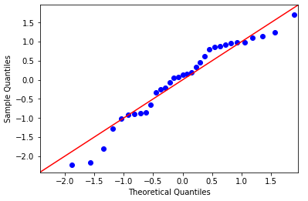
QQ Plot in Python
# Output
Interpretation:
Most of these points are close to the line except few values indicating no serious deviation from Normality.

Slide 15
Shapiro Wilk Test
Objective | To correlate, sample ordered values with expected Normal scores in order to test normality of the sample
Null Hypothesis (H₀): Sample is drawn from Normal Population
Alternate Hypothesis (H₁): Not H₀
Test Statistic
Decision Criteria | Reject the null hypothesis if p-value < 0.05

Slide 16
Shapiro Wilk Test in Python
# Shapiro Wilk Test
shapiro() from scipy package, returns correlation coefficient w and p-value.
import scipy as sp sp.stats.shapiro(perindex.res)
# Output
Interpretation:
p-value>0.05, Do not reject H₀. Normality can be assumed.

Slide 17
Case Study - Modelling Resale Price of Cars
Background
A car garage has old cars for resale. They keep records for different models of cars and their specifications.
Objective
To predict the resale price based on the information available about the engine size, horse power, weight and years of use of the cars
Available Information
Records -26
Independent Variables: engine size, horse power, weight and years
Dependent Variable: resale price

Slide 18
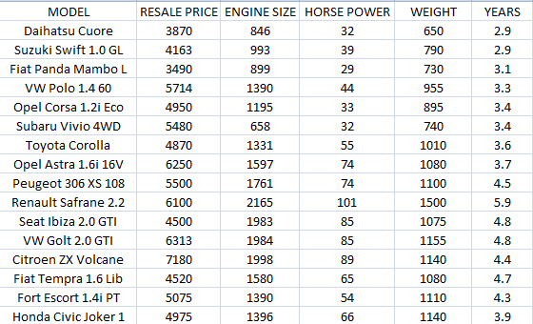
Data Snapshot
Car price data
Dependent variable
Independent variables
Columns | Description | Type | Measurement | Possible values
MODEL | Model of the car | character | - | -
RESALE PRICE | Resale price | numeric | Euro | positive values
ENGINE SIZE | Size of the engine | numeric | cc | positive values
HORSE POWER | Power of the engine | numeric | kW | positive values
WEIGHT | Weight of the car | numeric | kg | positive values
YEARS | Number of years in use | numeric | - | positive values
Observations

Slide 19
Correlation Matrix
# Importing the Data
ridgedata=pd.read_csv(”car price data.csv")
# Graphical representation of data
# Install and load package “seaborn”
import seaborn as sns import matplotlib.pyplot as plt sns.pairplot(ridgedata[['MODEL', 'RESALE PRICE', 'ENGINE SIZE', 'HORSE POWER','YEARS']]);plt.title('Fig.No. 2: ScatterPlot Matrix')
pairplot() in the package seaborn is used to plot the scatter plot matrix

Slide 20
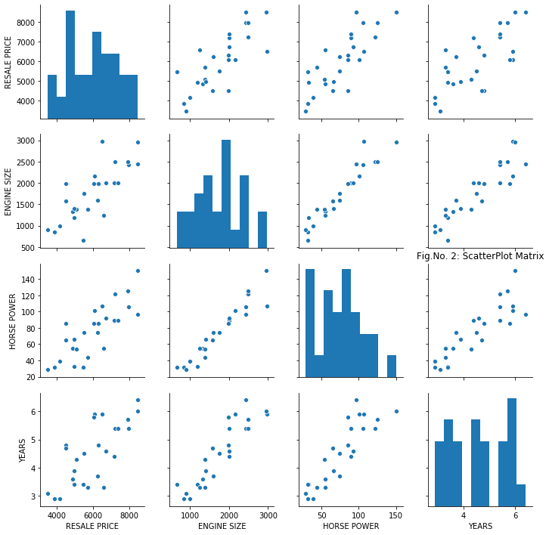
Scatter Plot Matrix
# Output
Interpretation :
The independent variables have high positive correlation among themselves .

Slide 21
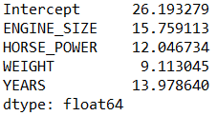
Detecting Multicollinearity in Python
#Importing the Data, Fitting Linear Model
ridgedata.columns = [c.replace(' ', '_') for c in ridgedata.columns] model = smf.ols('RESALE_PRICE~ENGINE_SIZE+ HORSE_POWER + WEIGHT + YEARS', data = ridgedata).fit()
In pandas, the column names cannot contain spaces in between. Hence, before applying ols() remove spaces from column names wherever required.
#Variance Inflation Factor
y, X = dmatrices('RESALE_PRICE~ENGINE_SIZE+ HORSE_POWER + WEIGHT + YEARS', data=ridgedata, return_type="dataframe") vif = pd.Series([variance_inflation_factor(X.values, i)for i in range(X.shape[1])],index=X.columns) vif
Interpretation:
VIF values for all the variables are greater than 5, hence we can conclude that there exist Multicollinearity between the independent variables.
# Output

